Slide 1
24
Measuring the Cost of Living

Slide 2
Measuring the Cost of Living
Inflation refers to a situation in which the economy’s overall price level is rising.
The inflation rate is the percentage change in the price level from the previous period.

Slide 3
THE CONSUMER PRICE INDEX
The consumer price index (CPI) is a measure of the overall cost of the goods and services bought by a typical consumer.
The Bureau of Labor Statistics reports the CPI each month.
It is used to monitor changes in the cost of living over time.

Slide 4
THE CONSUMER PRICE INDEX
When the CPI rises, the typical family has to spend more dollars to maintain the same standard of living.

Slide 5
How the Consumer Price Index Is Calculated
Fix the Basket: Determine what prices are most important to the typical consumer.
  The Bureau of Labor Statistics (BLS) identifies a market basket of goods and services the typical consumer buys.
  The BLS conducts monthly consumer surveys to set the weights for the prices of those goods and services.

Slide 6
How the Consumer Price Index Is Calculated
Find the Prices: Find the prices of each of the goods and services in the basket for each point in time.

Slide 7
How the Consumer Price Index Is Calculated
Compute the Basket’s Cost: Use the data on prices to calculate the cost of the basket of goods and services at different times.

Slide 8
How the Consumer Price Index Is Calculated
Choose a Base Year and Compute the Index:
  Designate one year as the base year, making it the benchmark against which other years are compared.
  Compute the index by dividing the price of the basket in one year by the price in the base year and multiplying by 100.

Slide 9
How the Consumer Price Index Is Calculated
Compute the inflation rate: The inflation rate is the percentage change in the price index from the preceding period.

Slide 10
How the Consumer Price Index Is Calculated
The Inflation Rate
  The inflation rate is calculated as follows:

Slide 11

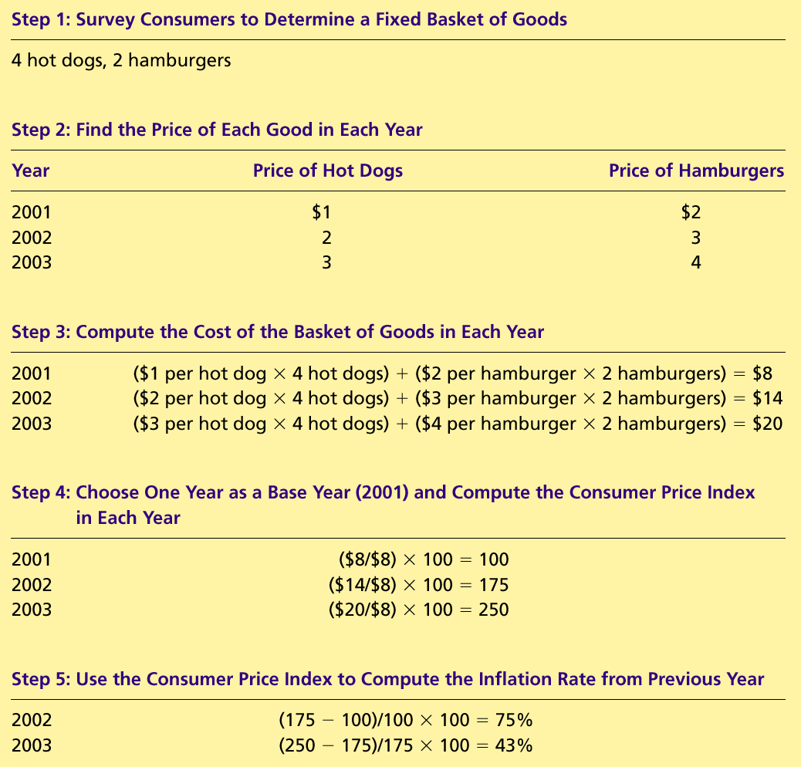
Table 1 Calculating the Consumer Price Index and the Inflation Rate: An Example
Copyright©2004 South-Western

Slide 12
Table 1 Calculating the Consumer Price Index and the Inflation Rate: An Example
Copyright©2004 South-Western

Slide 13
Table 1 Calculating the Consumer Price Index and the Inflation Rate: An Example
Copyright©2004 South-Western

Slide 14
Table 1 Calculating the Consumer Price Index and the Inflation Rate: An Example
Copyright©2004 South-Western

Slide 15
Table 1 Calculating the Consumer Price Index and the Inflation Rate: An Example
Copyright©2004 South-Western

Slide 16
How the Consumer Price Index Is Calculated
Calculating the Consumer Price Index and the Inflation Rate: Another Example
  Base Year is 2002.
  Basket of goods in 2002 costs $1,200.
  The same basket in 2004 costs $1,236.
  CPI = ($1,236/$1,200) × 100 = 103.
  Prices increased 3 percent between 2002 and 2004.

Slide 17

FYI: What’s in the CPI’s Basket?
16%
Food and
beverages
17%
41%
Transportation
Housing
Education and
6%
communication
6%
6%
4%
4%
Medical care
Other goods
Recreation
Apparel
and services
Copyright©2004 South-Western

Slide 18
Problems in Measuring the Cost of Living
The CPI is an accurate measure of the selected goods that make up the typical bundle, but it is not a perfect measure of the cost of living.

Slide 19
Problems in Measuring the Cost of Living
Substitution bias
Introduction of new goods
Unmeasured quality changes

Slide 20
Problems in Measuring the Cost of Living
Substitution Bias
  The basket does not change to reflect consumer reaction to changes in relative prices.
    Consumers substitute toward goods that have become relatively less expensive.
    The index overstates the increase in cost of living by not considering consumer substitution.

Slide 21
Problems in Measuring the Cost of Living
Introduction of New Goods
  The basket does not reflect the change in purchasing power brought on by the introduction of new products.
    New products result in greater variety, which in turn makes each dollar more valuable.
    Consumers need fewer dollars to maintain any given standard of living.

Slide 22
Problems in Measuring the Cost of Living
Unmeasured Quality Changes
  If the quality of a good rises from one year to the next, the value of a dollar rises, even if the price of the good stays the same.
  If the quality of a good falls from one year to the next, the value of a dollar falls, even if the price of the good stays the same.
  The BLS tries to adjust the price for constant quality, but such differences are hard to measure.

Slide 23
Problems in Measuring the Cost of Living
The substitution bias, introduction of new goods, and unmeasured quality changes cause the CPI to overstate the true cost of living.
  The issue is important because many government programs use the CPI to adjust for changes in the overall level of prices.
  The CPI overstates inflation by about 1 percentage point per year.

Slide 24

The GDP Deflator versus the Consumer Price Index
The GDP deflator is calculated as follows:

Slide 25
The GDP Deflator versus the Consumer Price Index
The BLS calculates other prices indexes:
  The index for different regions within the country.
  The producer price index, which measures the cost of a basket of goods and services bought by firms rather than consumers.

Slide 26
The GDP Deflator versus the Consumer Price Index
Economists and policymakers monitor both the GDP deflator and the consumer price index to gauge how quickly prices are rising.
There are two important differences between the indexes that can cause them to diverge.

Slide 27
The GDP Deflator versus the Consumer Price Index
The GDP deflator reflects the prices of all goods and services produced domestically, whereas...
…the consumer price index reflects the prices of all goods and services bought by consumers.

Slide 28
The GDP Deflator versus the Consumer Price Index
The consumer price index compares the price of a fixed basket of goods and services to the price of the basket in the base year (only occasionally does the BLS change the basket)...
…whereas the GDP deflator compares the price of currently produced goods and services to the price of the same goods and services in the base year.

Slide 29

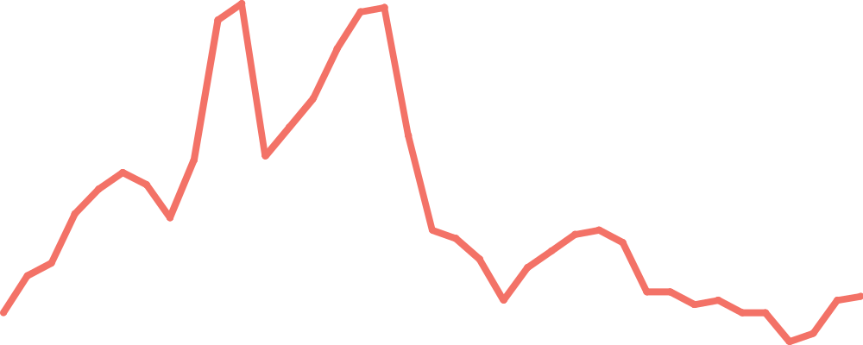
Figure 2 Two Measures of Inflation
Percent
per Year
15
CPI
10
5
GDP deflator
0
1965
1970
1975
1980
1985
1990
1995
2000
Copyright©2004 South-Western

Slide 30
CORRECTING ECONOMIC VARIABLES FOR THE EFFECTS OF INFLATION
Price indexes are used to correct for the effects of inflation when comparing dollar figures from different times.

Slide 31
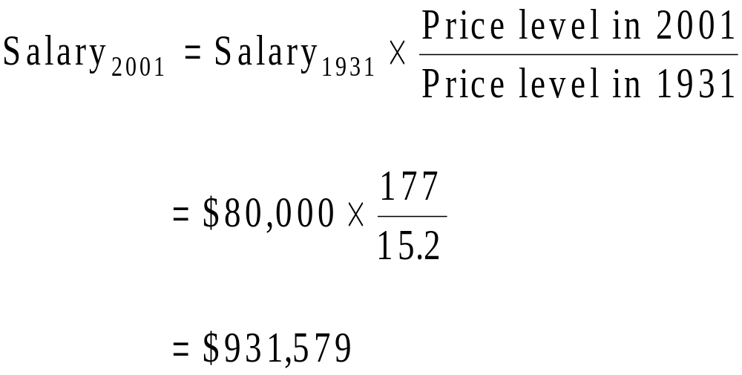
Dollar Figures from Different Times
Do the following to convert (inflate) Babe Ruth’s wages in 1931 to dollars in 2001:

Slide 32
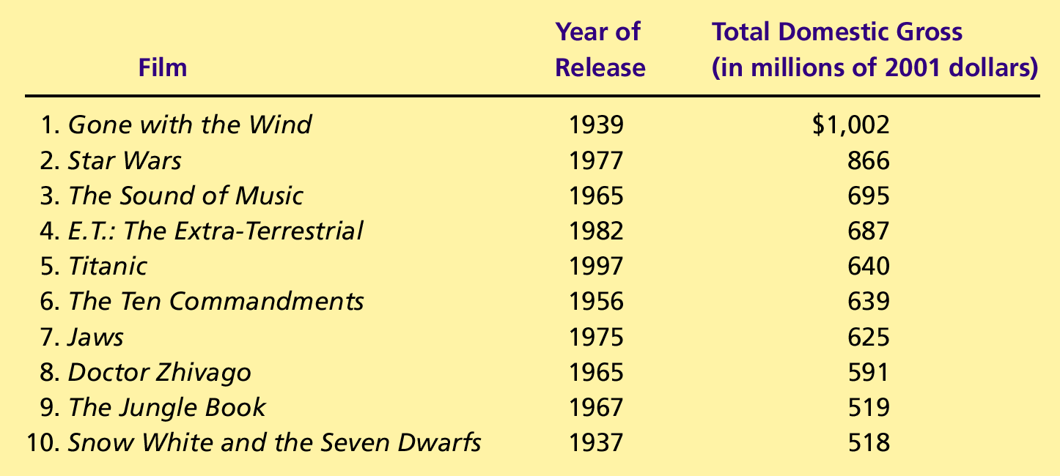
Table 2 The Most Popular Movies of All Times, Inflation Adjusted
Copyright©2004 South-Western

Slide 33
Indexation
When some dollar amount is automatically corrected for inflation by law or contract, the amount is said to be indexed for inflation.

Slide 34
Real and Nominal Interest Rates
Interest represents a payment in the future for a transfer of money in the past.

Slide 35
Real and Nominal Interest Rates
The nominal interest rate is the interest rate usually reported and not corrected for inflation.
  It is the interest rate that a bank pays.
The real interest rate is the nominal interest rate that is corrected for the effects of inflation.

Slide 36
Real and Nominal Interest Rates
You borrowed $1,000 for one year.
Nominal interest rate was 15%.
During the year inflation was 10%.
Real interest rate = Nominal interest rate – Inflation
= 15% - 10% = 5%

Slide 37

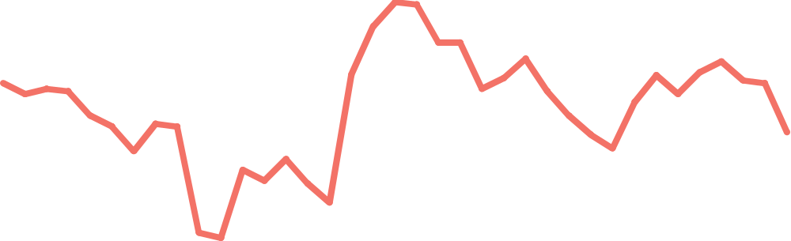
Figure 3 Real and Nominal Interest Rates
Interest Rates
(percent
per year)
15
10
Nominal interest rate
5
0
Real interest rate
–5
1965
1970
1975
1980
1985
1990
1995
2000
Copyright©2004 South-Western

Slide 38
Summary
The consumer price index shows the cost of a basket of goods and services relative to the cost of the same basket in the base year.
The index is used to measure the overall level of prices in the economy.
The percentage change in the CPI measures the inflation rate.

Slide 39
Summary
The consumer price index is an imperfect measure of the cost of living for the following three reasons: substitution bias, the introduction of new goods, and unmeasured changes in quality.
Because of measurement problems, the CPI overstates annual inflation by about 1 percentage point.

Slide 40
Summary
The GDP deflator differs from the CPI because it includes goods and services produced rather than goods and services consumed.
In addition, the CPI uses a fixed basket of goods, while the GDP deflator automatically changes the group of goods and services over time as the composition of GDP changes.

Slide 41
Summary
Dollar figures from different points in time do not represent a valid comparison of purchasing power.
Various laws and private contracts use price indexes to correct for the effects of inflation.
The real interest rate equals the nominal interest rate minus the rate of inflation.

